Slide 1
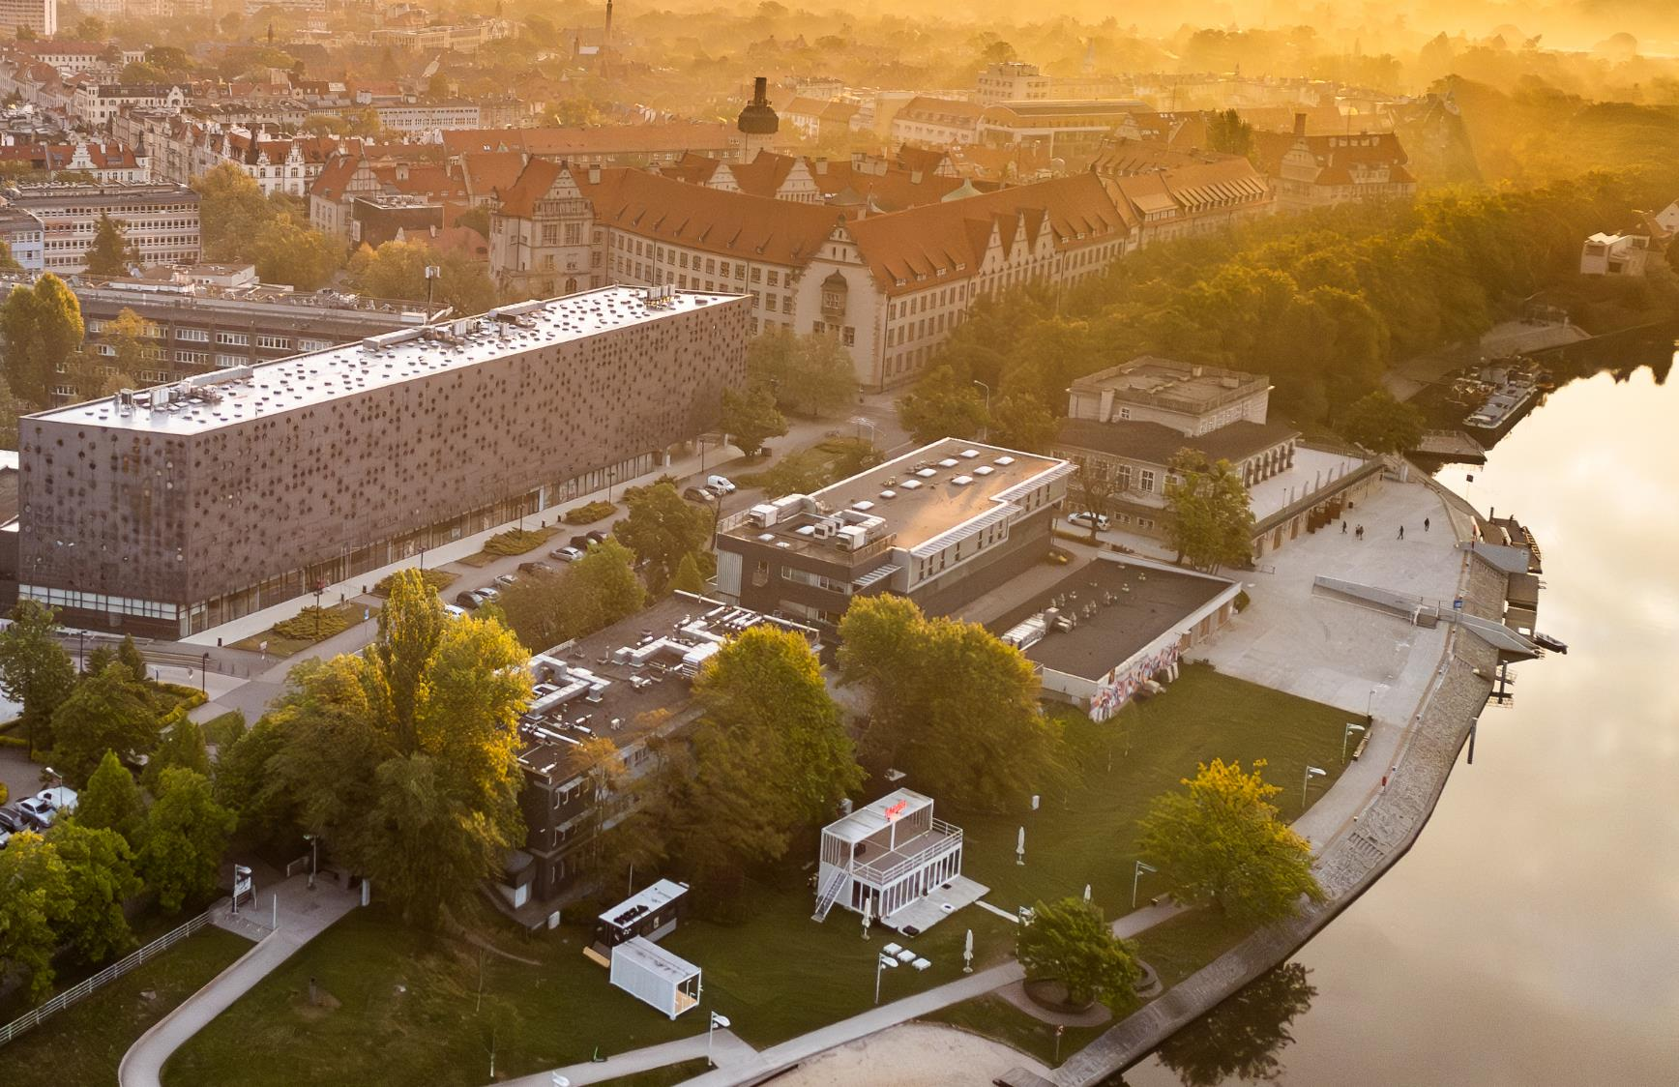
WrocŁaw University of Science and Technology

Slide 2


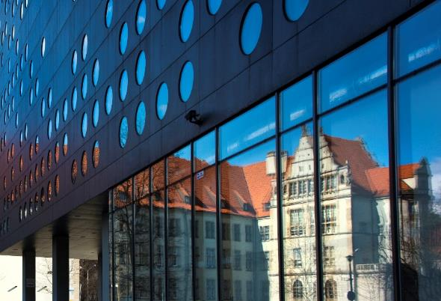
History
  Today’s Wrocław University of Science and Technology
  is the heir to the material legacy of the German Königliche Technische Hochschule Breslau and the intellectual and research traditions of the Lviv University of Technology.
  The university is using its current name since 1945.
  It was established and organized by scientists from Lviv and Warsaw. Since the very beginning of its existence,
  it has been an important centre of technical education.
  Today it is one the best technical universities in Poland
  – 21 000 students study here under the guidance of 2 399 academic teachers, at 14 Faculties in Wroclaw and
  3 branches in Jelenia Gora, Legnica, Walbrzych.
Notes:
Stan na 31.12.2024 r. (GUS)
17 368 studentów na I stopniu
100 studentów JSM (na kierunku lekarskim)
2820 studentów na II stopniu
758 doktorantów w Szkole Doktorskiej

Slide 3
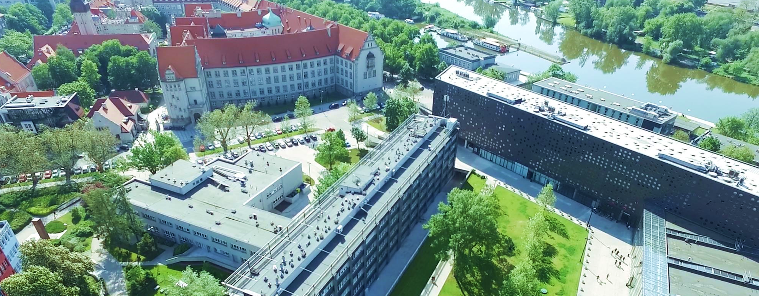
Mission
Through research, teaching, and collaboration we inspire and support the development
of individuals who, based on knowledge, ethical standards and displaying sensitivity to the needs of society and global challenges, shape the future with courage and responsibility.

Slide 4

Numbers
72
BSc/MSc/Eng
fields of studies
2 300
permanent academic staff
21 000
students including 800
Phd students
53
scientists
on Stanford TOP 2% list of world’s most influential
researchers
14
scientific disciplines in
4
fields of science, including
all from Engineering
& Technology
33
programmes
in English
14
faculties
and
1 400
international
students
3
regional branches
Notes:
31.12.2024

Slide 5
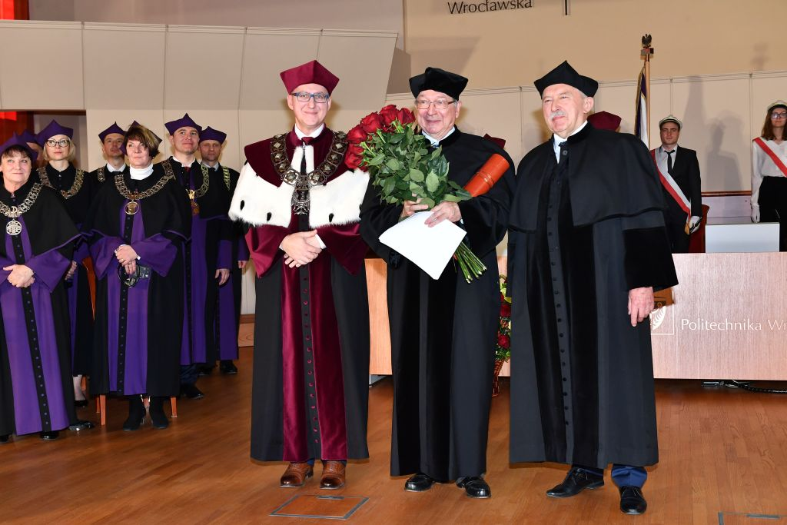
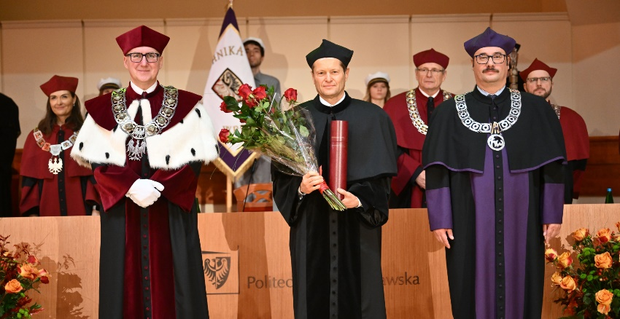
Doctors Honoris Causa
José Manuel Barroso
Daniel Józef Bem
Horst Berthold
Eckhard Beyer
Georgij Konstantynowicz
Boreskow
Andrzej Burghardt
Philippe Busquin
Jerzy Buzek
Gabriel Crean
Eugeniusz Dembicki
Georgij Iwanowicz Denisenko
Karel Duŝek
Rafał Dutkiewicz
Kurt Feser
Alfred Forchel
Elbert Kirtley Fretwell
Kardynał Henryk Gulbinowicz
Henryk Hawrylak
Stanisław Hückel
Giennadij Aleksiejewicz Jagodin
Andrzej Jellonek
Bogusława Jeżowska-
-Trzebiatowska
Moisey I. Kaganov
Alan R. Katritzky
Igor Ignacy Kisiel
Joseph Klafter
Jan Kmita
Ferenc Krausz
Stanisław Kulczyński
Krzysztof Kurzydłowski
Philippe Lebrun
Stanisław Lem
Jerzy Leszczyński
Nikołaj Nikołajewicz Malinin
Marja Makarow
Achim Mehlhorn
Jean Meinnel
Angela Merkel
Gérard Mourou
Anatolij Nikołajewicz
Minkiewicz
Kazuo Nakamoto
Reimund Neugebauer
Jean Nougaro
Volodymir V. Panasyuk
Zdzisław J. Pręgowski
Ilya Prigogine
Günter Pritschow
Bengt Ranby
Błażej Roga
Jurij Rudawski
Wacław Franciszek Sierpiński
Jerzy Ignacy Skowroński
Dionizy Smoleński
Joachim Klaus Strzodka
Frans Louis H. M. Stumpers
Karol Széchy
Zygmunt Szparkowski
Władysław Ślebodziński
Ryszard Tadeusiewicz
Hamadoun I. Touré
Jan Trojak
Włodzimierz Trzebiatowski
Kazimierz Urbanik
Zenon Wiłun
Andrzej Wiszniewski
Wojciech Witkiewicz
Władysław Karol Włosiński
Michel Virlogeux
2022, prof. Michel Virlogeux (École Nationale des Ponts et Chaussées, France) French structural engineer and bridge specialist; designer of Millau Viaduct
2024, prof. Ferenc Krausz (Max Planck Institute
of Quantum Optics, Germany) Hungarian scientist; Nobel Prize 2023 in physics for: attosecond pulses
of light
Notes:
pwr.edu.pl/uczelnia/informacje-ogolne/historia-i-rozwoj/osobistosci/doktorzy-honoris-causa

Slide 6

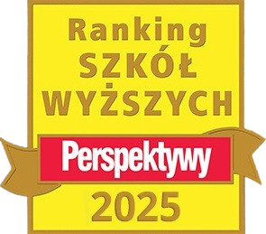



Wrocław Tech in the rankings
Perspektywy University Ranking 2025
7th place in the general ranking of universities
4th place among Polish technical universities
Shanghai Global Ranking of Academic Subjects 2024
Mechanical Engineering ranked 101-150
Center for World University Ranking 2025-2026
13th place among Polish universities and scientific institutions included
in the ranking
THE Interdisciplinary Science Rankings 2025
2nd place among Polish universities
in group 201-250 in the general ranking of universities
Notes:
Times Higher Education Interdisciplinary Science Rankings 2025
2nd place among Polish universities
in group 201-250 in the general ranking of universities
The Interdisciplinary Science Rankings is the first effort of its kind to measure universities’ contributions and commitment to interdisciplinary science. It includes 11 carefully calibrated performance indicators to assess institutions across three key areas, each representing a stage in the life cycle of research projects: inputs (funding); process (measures of success, facilities, administrative support and promotion); and outputs (publications, research quality and reputation).

Slide 7

Wrocław Tech in the rankings
QS World University Rankings 2026
10th place among Polish universities
28th place in QS Europe University Rankings – Eastern Europe
QS World University Rankings by Subject 2025
Engineering and Technology – 304th position worldwide, 2nd place among Polish universities
Natural Sciences – 393th position worldwide, 4th place among Polish universities
Subjects:
Mechanical Engineering – ranked 251-300
Electrical and Electronic Engineering – ranked 251-300
Chemical Engineering – ranked 351-400
Computer Sciences and Information Systems – ranked 451-500
Material Sciences – ranked 251-300
Mathematics – ranked 351-400
Chemistry – ranked 501-550
Physics and Astronomy – ranked 401-450
Notes:
Times Higher Education Interdisciplinary Science Rankings 2025
2nd place among Polish universities
in group 201-250 in the general ranking of universities
The Interdisciplinary Science Rankings is the first effort of its kind to measure universities’ contributions and commitment to interdisciplinary science. It includes 11 carefully calibrated performance indicators to assess institutions across three key areas, each representing a stage in the life cycle of research projects: inputs (funding); process (measures of success, facilities, administrative support and promotion); and outputs (publications, research quality and reputation).

Slide 8
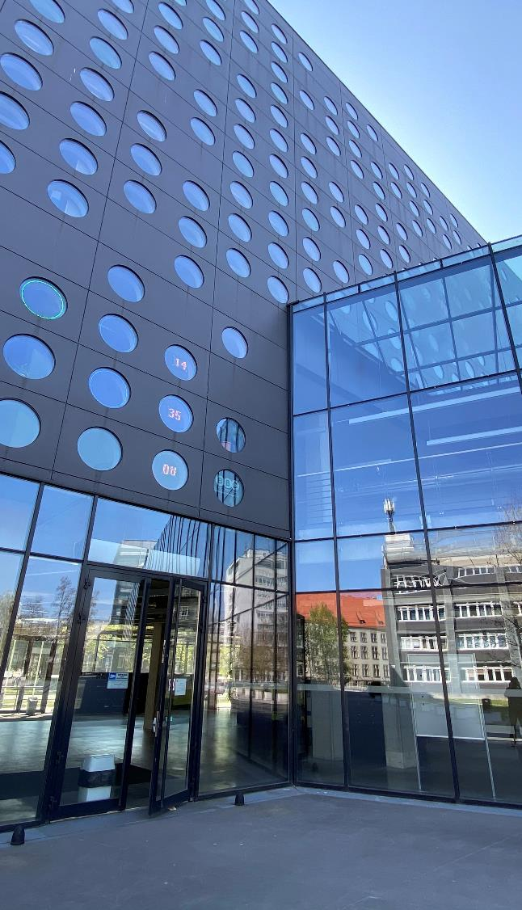
Key Strategic Areas
To implement the University’s mission and vision and to support and promote its values, this Strategy defines five key strategic areas:
Education
Research and Innovation
Cooperation with the Environment
Community
Infrastructure.

Slide 9

Education
EDUCATION

Slide 10
Fields
Engineering and technology:
Architecture and urban planning
Automation, electronics, electrical engineering
and space technologies
Biomedical engineering
Chemical engineering
Civil engineering, geodesy and transport
Environmental engineering, mining, and energy
Information and communication technology
Materials engineering
Mechanical engineering
Natural sciences:
Chemical sciences
Mathematics
Physical sciences
Social sciences:
Management
and quality studies
Medical and health sciences:
Medical sciences
Notes:
Since its very beginnings, Wrocław Tech has aimed to deliver high quality education. Its multidisciplinary character goes beyond the traditional fields of engineering, interweaving technical, mathematical, natural and economic sciences with humanities.
nazwy dyscyplin w języku angielskim – załącznik nr 2 do PO 6/2024
Architecture and Urban Planning
Automation, Electronics, Electrical Engineering and Space Technologies
Information and Communication Technology
Biomedical Engineering
Chemical Engineering
Civil Engineering, Geodesy and Transport
Materials Engineering
Mechanical Engineering
Environmental Engineering, Mining and Energy
Mathematics
Chemical Sciences
Physical Sciences
Management and Quality Studies
Medical Sciences

Slide 11














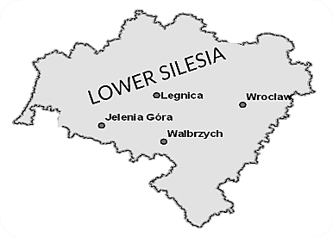
14 Faculties
Architecture
Civil Engineering
Chemistry
Information and Communication Technology
Electrical Engineering
Geoengineering, Mining and Geology
Environmental Engineering
Management
Mechanical and Power Engineering
Mechanical Engineering
Fundamental Problems of Technology
Electronics, Photonics and Microsystems
Pure and Applied Mathematics
Medicine
Doctoral School
Academic High School
> 10 Interdisciplinary Research Centers
Networking and Supercomputing Center
Entrepreneurship Incubator, Tech Transfer Centre, Business & Innovation Centre
3 BRANCHES
Notes:
wykaz nazw wydziałów, kierunków studiów, specjalności w języku angielskim – załącznik nr 1 do PO 6/2024

Slide 12

Doctoral school
The Wrocław University of Science and Technology Doctoral School began its operation on October 1, 2019. Candidates can take up education in one
of thirteen disciplines:
Field of engineering and technical sciences
Architecture and Urban Planning
Automation, Electronics, Electrical Engineering and Space Technologies
Information and Communication Technology
Biomedical Engineering
Chemical Engineering
Civil Engineering, Geodesy and Transport
Mechanical Engineering
Materials Engineering
Environmental Engineering, Mining and Energy
Field of exact and natural sciences
Mathematics
Chemical Sciences
Physical Sciences
Field of social sciences
Management and Quality Studies

Slide 13

Education quality and accreditation
European Chemistry Thematic Network
Chemistry Doctorate Eurolabel Certification for studies in Chemical Engineering
Eurobachelor Certification for studies in Chemistry and Industrial
Analytics, Chemical Technology
Euromaster Certification for studies in Chemistry and Chemical Technology
Science Evaluation Committee (KEN) discipline assessment 2017-2021:
Category A+:
Physical sciences
Chemical sciences
Mathematics
Chemical engineering
Category A:
Architecture and urban planning
Automation, electronics
and electrical engineering
Technical informatics and telecommunications
Biomedical engineering
Civil engineering and transportation
Mechanical engineering
Material Engineering
Environmental engineering, mining and energy
Management and Quality Sciences
European Consortium for Mathematics in Industry
accreditation for II degree of education studies in Applied Mathematics
Accreditation of Studies with a Future 2024
Sustainable Biomass and Bioproducts Engineering (SBBE)
European Accreditation of Engineering Programmes
accreditation for studies in Electotechnics
accreditation for studies in Civil Engineering
accreditation for Biotechnology, Chemical and Process Engineering,
Chemical Technology
Association of Academic Centers for Teaching Foreign Languages
Department of Foreign Languages of Wrocław Tech – distinctive grade
IES and ICI international certificate for graduates
accreditation for studies in Management
accreditation for studies in Business Engineering
All graduates of the certified educational programs are entitled to receive the IES and ICI international certificates

Slide 14
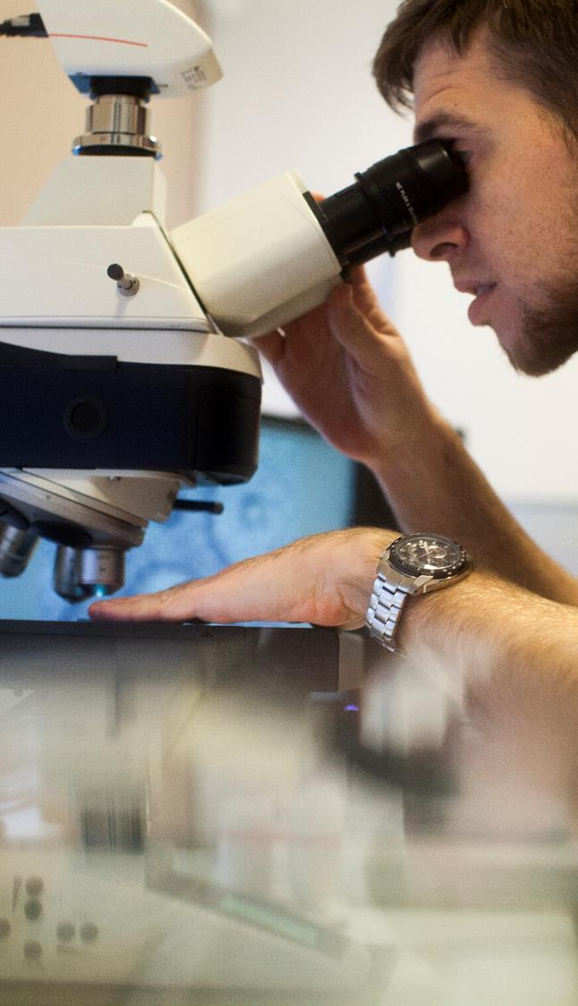

HR Excellence in Research
In June 2016 European Commission granted our University the logo "Human Resources Excellence in Research". The logo is given
to those institutions that apply the principles of the European Charter for Researchers and
the Code of Conduct for the Recruitment
of Researchers.
Logo "HR Excellence in Research" is awarded, among others, in international grant competitions of the European Commission, national grant competitions of the National Center for Science
and the National Centre for Research and Development and competitions and funding programs of the Ministry of Science and Higher Education.
Logo "HR Excellence in Research" emphasises the Wrocław University of Science and Technology importance as an institution which creates the best working conditions for scientists, implementing research and scientific development
in accordance with the European standards.

Slide 15
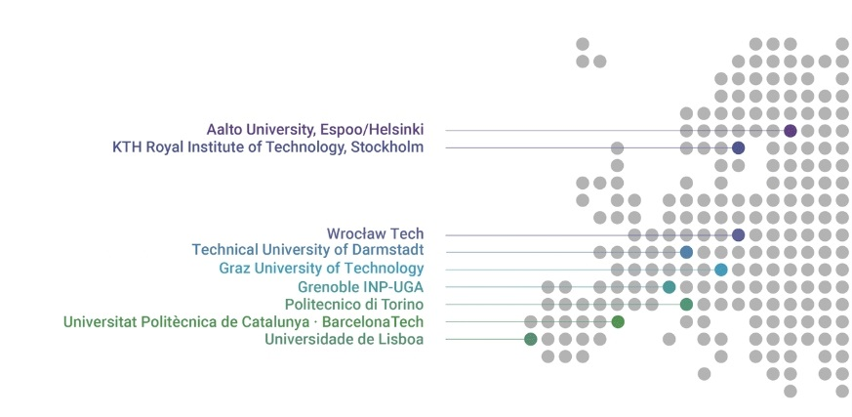

Wrocław Tech in „Unite!”
In 2022 Wrocław Tech joined the European university alliance „Unite!” – University Network
for Innovation, Technology and Engineering.
The aim of this elite organization, uniting universities from nine EU countries, is to create a model
of education that responds to the challenges of the modern world. The member universities focus
on continuous improvement of the teaching process, development of joint research projects
and a flexible study path, and combining science and humanities in the process of educating students.
Notes:
Sieć Unite!
Uniwersytet w Grenoble (Francja),
Uniwersytet w Lizbonie (Portugalia),
Królewski Instytut Technologiczny w Sztokholmie (Szwecja),
Aalto University (Finlandia),
Uniwersytet Techniczny w Darmstadt (Niemcy),
Politechnika w Turynie (Włochy),
Uniwersytet Techniczny Katalonii - Barcelona Tech (Hiszpania),
Politechnika Wrocławska,
Uniwersytet Techniczny w Graz (Austria).

Slide 16

International cooperation
International cooperation

Slide 17

Current international agreements
Bilateral cooperation agreements - inter-university and inter-faculty
196 partners from 45 countries
Bilateral student exchange agreements (student exchange)
29 partners from 16 countries
Double diploma agreements
14 partners from 6 countries
Agreements regarding academic mobility in the Erasmus+ program
500 active European agreements and 30 with partners from other countries
of the world.
INTERNATIONALISATION | 2024/2025
Foreign students on I study degree | 968
Foreign students on II study degree | 236
Foreign students in Doctoral School | 89
Incoming students including ERASMUS+ | 259
Students exchange including ERASMUS+ | 187
Notes:
Liczba cudzoziemców – stan na 31.12.2024 r.,

Slide 18


Program ERASMUS+
Participation of the Wrocław Tech students and doctoral students
Program | 2024/2025
Erasmus+ studies | 134
Erasmus+ student internships | 5
Erasmus+ short-term mobility | 48
Erasmus+ graduate internships | 12
Exchange | 8
Double Diploma | 14
TOGETHER | 221
Arrivals of students and doctoral students
Erasmus+ studies | 2024/2025
Erasmus+ KA 131 | 254
Erasmus+ KA 171 | 5
Visiting Student | 0
Exchange | 20
Erasmus Mundus | 46
Double Diploma | 2
TOGETHER | 327
Notes:
Stan na 31.12.2024

Slide 19

Program ERASMUS+
Staff arrivals
Program | 2024/2025
Erasmus+ KA103 (lectures) | 6
Erasmus+ KA103 (training arrivals) | 38
Erasmus+ KA107 (training arrivals) | 3
TOGETHER | 47
Staff travels
Program | 2024/2025
Erasmus+ KA103 (lectures) | 25
Erasmus+ KA103 (training) | 47
Erasmus+ KA107 (lectures) | 3
TOGETHER | 75
Notes:
Stan na 31.12.2024

Slide 20

WROCŁAW TECH FOR THE YOUTH
WROCŁAW TECH FOR THE YOUTH

Slide 21

Wrocław University of Science and Technology for the youth
Open days
International Week, Summer Schools
Team programming contests
Lower Silesian Festival of Science
Competition in maths and logic games
Chemistry contest
Young Researchers Academy
Courses for candidates
Cooperation with secondary schools
Polilab
Studium talent
Robotic Arena
PWr Challenge
Girls' TechPower
Notes:
@polilabPWr
roboticarena.pl/pl/
prk.pwr.edu.pl/projekty/wspolpraca-ze-szkolami-srednimi
prk.pwr.edu.pl/projekty/szkoly-partnerskie
amo.pwr.edu.pl/
prk.pwr.edu.pl/projekty/wybitnie-uzdolnieni-na-pwr

Slide 22

Student activities
223 Scientific organizations
Among others: PWR Racing Team, PIRM Mobile Vehicles and Robots Scientific Circle, Students Scientific Society KoNaR, Academic Aviation Club, Bio-Top, ALLIN, Wireless Group, PWR Solar Boat Team, Energy Loop, Audio Engineering Society AES
29 Student associations
Among students’ organizations, the ones with national or international span are the most distingushing and active: BEST Wrocław, AIESEC, NZS, IAESTE, SEP, Erasmus Student Network ESN.
21 Student culture centres
Among others: POLITECHNIKA Film Discussion Club, Wrocław University of Science and Technology Academic Choir, BIG BAND music group, FOSA Academic Filmmakers Club, SpAF Association of Para-artistic Photography, University’s Orchestra, STYK Students Television.

Slide 23

Modern University
Prospective students:
on-line registration at: rekrutacja.pwr.edu.pl/en
official website: pwr.edu.pl
Students:
electronic student ID
electronic student record book
cooperation with companies and institutions, opportunities
for internships and trainings biurokarier.pwr.edu.pl
Teaching:
studying in foreign languages

Slide 24

RESEARCH AND INNOVATION
Research and Innovation

Slide 25
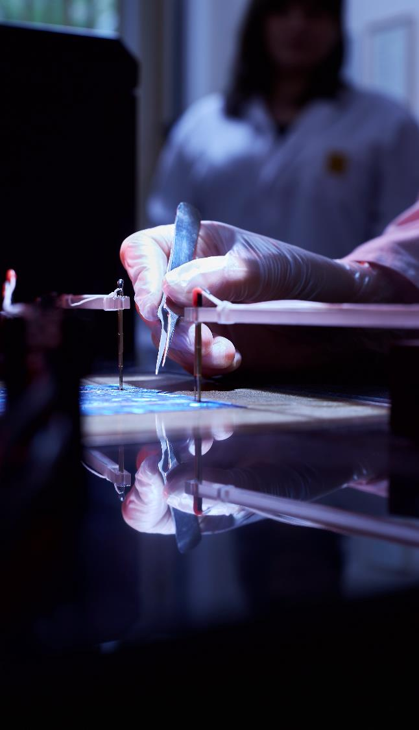
Scientific research results
25 968 publications in journals on the ISI Master Journal List
24 102 publications in JCRI indexed journals
39 570 WOS indexed publications
61 highly cited papers
  6 327 registered inventions, including utility models
  2 839 patents obtained
Notes:
liczba publikacji – stan na dzień 26.06.2025 r.
Publikacje zarejestrowane w bazie DONA.
25 887 liczba publikacji w czasopismach z Listy Filadelfijskiej
24 016 liczba publikacji w czasopismach z Impact Factor (JCR)
Dane dot. prac afiliowanych do PWR (wszystkie typy publikacji) w bazie WoS
39,570 WOS indexed publications
61 highly cited papers
1. Aktualna łączna liczba zgłoszonych do ochrony wynalazków i innych praw ochronnych stan na dzień 25.06.2025: 6327 szt. (w tym 4482 zgłoszenia do 31.12.2009 r.)
- dane do 31.12.2009 r na podstawie papierowych rejestrów zgłoszeń prowadzonych przez PWr,
- dane po 01.01.2010 na podstawie SLU (wewnętrznego systemu ewidencyjnego PWr.)
2. Aktualna liczba uzyskanych patentów i innych praw ochronnych stan na dzień 25.06.2025: co najmniej: 2839 szt. - dane na podstawie wyszukiwarki urzędu patentowego oraz SLU (wewnętrznego systemu ewidencyjnego PWr).

Slide 26


Cooperation with industry
TRAINING RESEARCH TECHNOLOGY EXPERTISE APPLICATION
Goals
Joint research and implementation work in various industry sectors
Development of new technologies
Cooperation on using research, teaching and training facilities
Opportunities for internships, student stays and diploma theses
Alumni career support
Development of academic entrepreneurship
Commercialization of research results
Preparation and implementation of projects financed from domestic and foreign funding
Promotion of modern technologies
Notes:
biznes.pwr.edu.pl/en/

Slide 27
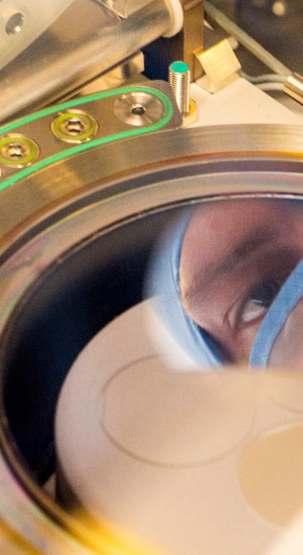
Priority Research Areas
Information Technology, Data Science and Artificial Intelligence
Innovative Materials and Advanced Manufacturing
Sustainable Living Environment
Smart Cities and Future Society
Health and Medical Technologies
Extreme Technologies
Basic Research for Technology and Innovation
All priority research areas are interdisciplinary and cross the structure of faculties. They collectively represent every research topic in which Wrocław Tech either currently plays or aims to assume a leading role in Poland and the global impact.

Slide 28

Information Technology, Data Science and Artificial Intelligence (1/7)
Computer science, algorithmics and software engineering, artificial intelligence and machine learning, human-computer interaction, methods of data analysis and visualization, mathematical statistics, classification and forecasting, natural language processing, quantum computing, data storage and transmission engineering, information processing and privacy, cybersecurity and cryptography, telecommunication, computer and mobile networks, cyber-cloning and virtualization, augmented and virtual reality, multimedia techniques, medical informatics and neuroinformatics, autonomous systems.
Centre for Information and Communication Technologies
Centre for Trusted Information and Telecommunication Systems
Centre for Defence and Security

Slide 29
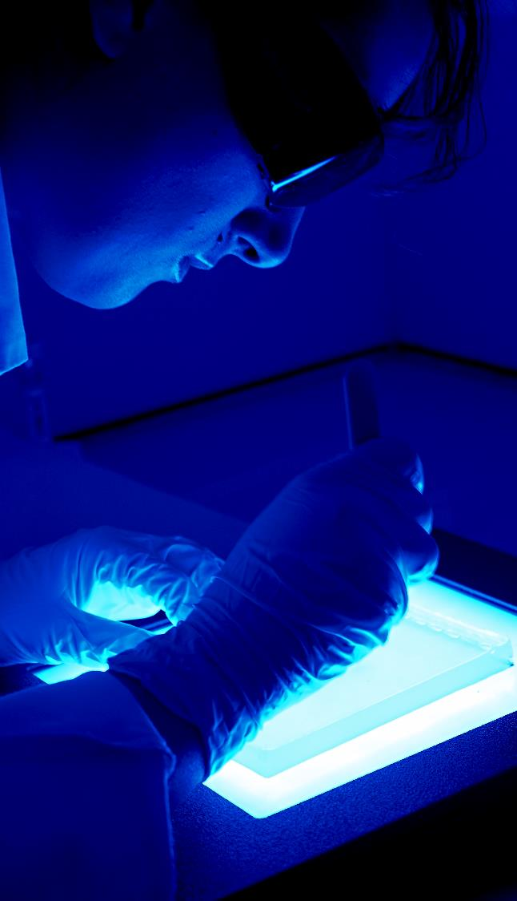
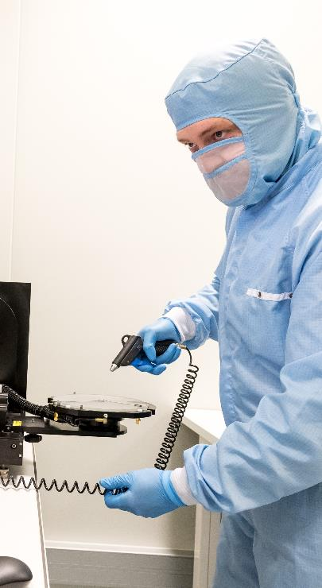
Innovative Materials and Advanced Manufacturing (2/7)
Basic research and materials engineering, Industry 4.0 (digitization, automation and hiper-automation, robotization, and intelligent production systems), additive technologies, high-
-precision technologies, green technologies using a renewable resource base and valorization of waste, sustainable and energy-
-saving technologies, use of innovative methods and tools, and control systems.
Centre for Material Engineering and Metal Forming
Centre for Advanced Materials and Nanotechnology
Centre for Defence Innovation and Technology

Slide 30

Sustainable Living Environment (3/7)
This area includes, among others, resource management, energy sources (conventional, renewable, and nuclear energy), energy system transformation, human- and environment-
-friendly technologies (e.g., electromobility), protection of climate as well as natural and cultural environment, water management, identification of environmental hazards and response to natural disasters, as well as all aspects of sustainable development, circular economy, and social acceptance of changes.
Centre for Sustainable Development and Climate Protection
Centre for Advanced Raw Materials and Energy Technologies
Research Centre for Sustainable Built Environment

Slide 31
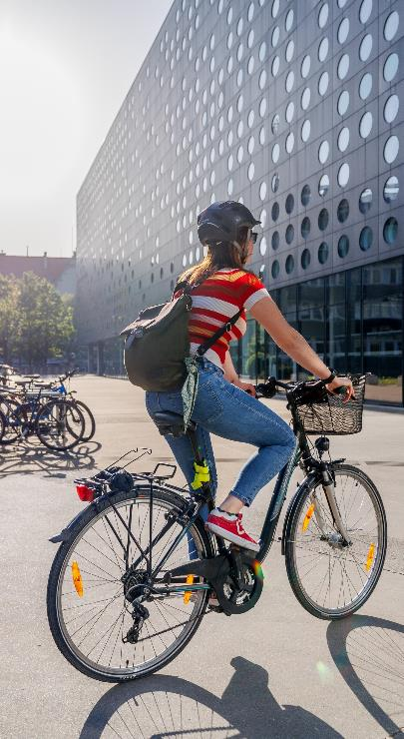
Smart Cities and Future Society (4/7)
Holistic design and construction of human-friendly buildings, estates, and cities using modern technologies, application of innovative and safe materials, broadly understood communication and mobility – including intelligent and autonomous transport systems, universal design, prevention and counteraction of social, energy and digital exclusion, research on human-machine interactions, as well as analysis, prediction, and management of social and economic processes.
Centre for Urban Innovation: Architecture, Engineering, Technology, Mobility

Slide 32
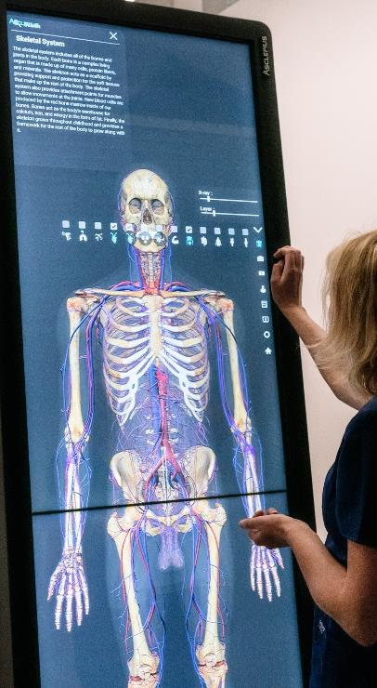
Health and Medical Technologies (5/7)
This area reflects the ongoing process of medical technization and an increasingly close relationship between progress in medicine and technological development.
It includes interdisciplinary research at the intersection of health sciences and basic and technical sciences, as well as strictly medical research. In particular, it includes such areas as biochemistry and biological chemistry, bionics, biomedical engineering, biomechanics, materials mimicking nature and promoting health, medical electronics and sensors, bioinformatics, analysis of images and large sets of medical data, medical diagnostics, personalized and precision medicine, digital technologies for health and medicine, telemedicine, human augmentation, and research on the health effects of environmental factors and social processes.
Health Tech Synergy Hub
Centre for Biomedical Engineering

Slide 33
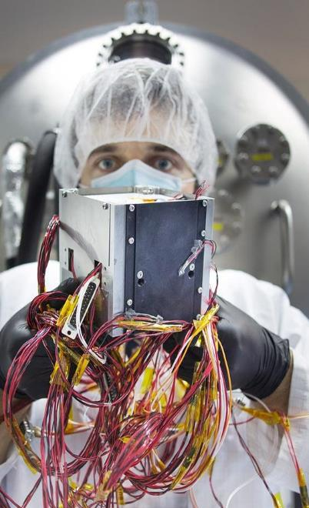
Extreme Technologies (6/7)
Nanotechnology, microelectronics and photonics, metrology, megastructures (large buildings, machines, devices, power grids, etc.), quantum technologies, cryogenic, space, marine, and underground technologies, i.e., research on phenomena of extreme scales and engineering of objects with extreme parameters or operating under extreme conditions.
Research Terahertz Technique Centre
Aviation Research and Development Centre
Centre for Micro-/Nanoelectronics, Micro-/Nanosystems, and Micro-/Nanoengineering

Slide 34
Basic Research for Technology and Innovation (7/7)
Research on fundamental objects, models, and theories important for understanding complex systems – from materials and processes to biological and social systems.
It considers the application of universal concepts and laws to the analysis of real phenomena and supports the development of technology and civilization and the improvement of human life quality and the state of the natural environment. It includes in particular research in the field of natural sciences (including mathematics, physics, and chemistry) as well as social sciences and humanities.
Hugo Steinhaus Centre
Ryll-Nardzewski Centre

Slide 35
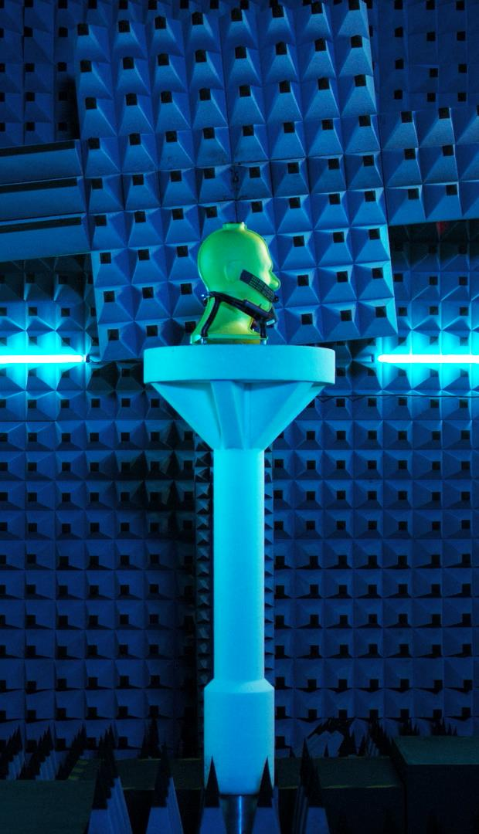
Certified laboratories
Accredited Laboratory of Standards and Metrology of the Electromagnetic Field (research and calibration laboratory)
Accredited Acoustics Testing Laboratory
Accredited Belt Transport Laboratory
Accredited Work Safety Laboratory
Accredited Testing Laboratory for Transport Infrastructure Facilities
Accredited Laboratory for Electromagnetic Compatibility
Accredited Laboratory of the Department of Machine Design
and Testing
Accredited Chemical Laboratory for Multi-element Analyzes
Notes:
8 laboratoriów akredytowanych

Slide 36
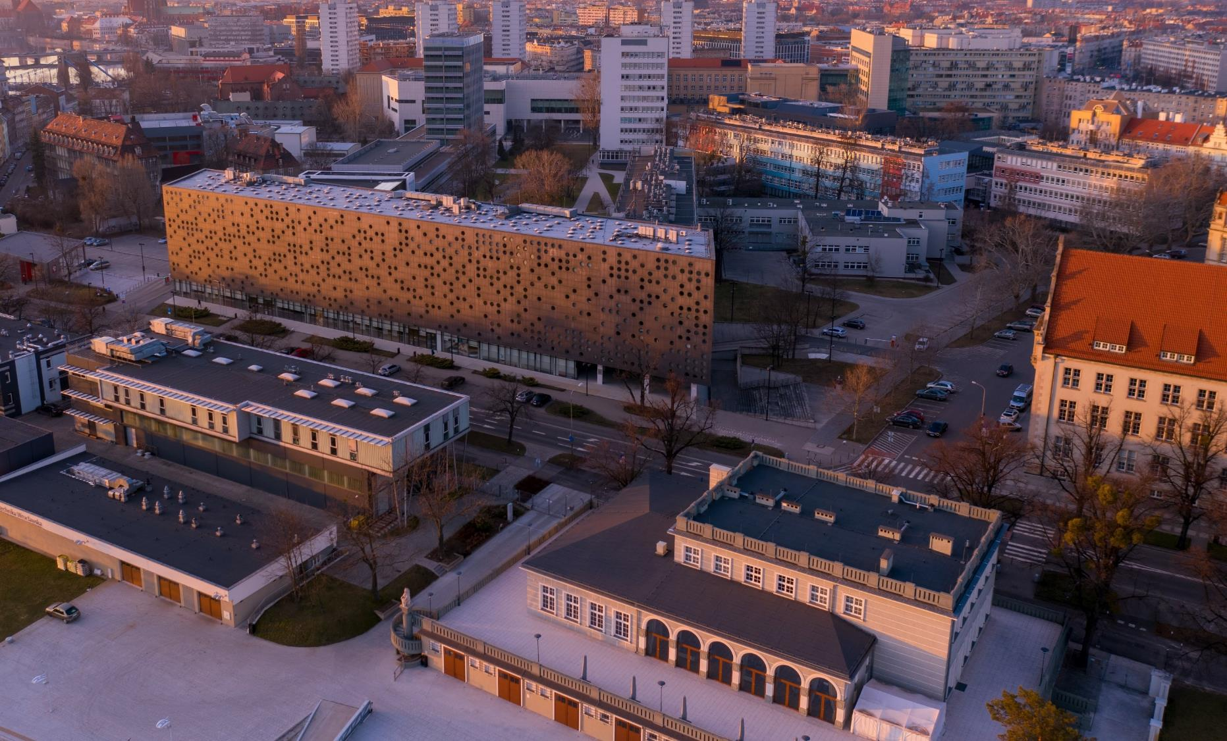
INFRASTRUCTURE
INFRASTRUCTURE

Slide 37
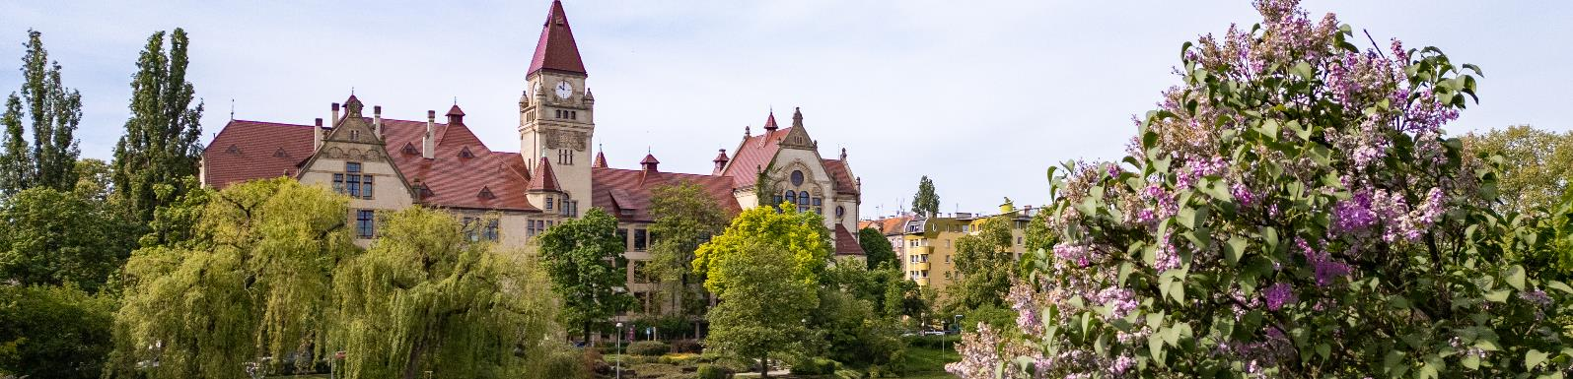
Research and teaching facilities
  116 buildings with modern laboratories, libraries and multimedia teaching rooms
  sports centre
  computer laboratories and reading rooms with 24h Internet connection
  579 didactic laboratories
  418 research laboratories
  111 research and teaching laboratories
  472 teaching rooms and lecture halls
Notes:
stan na 30.11.2024 r.

Slide 38
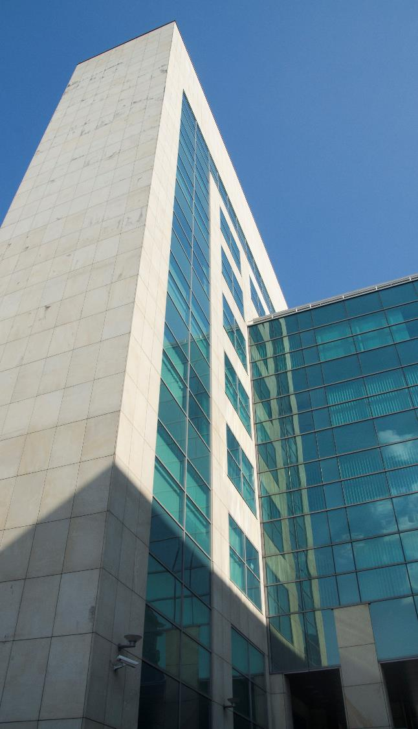
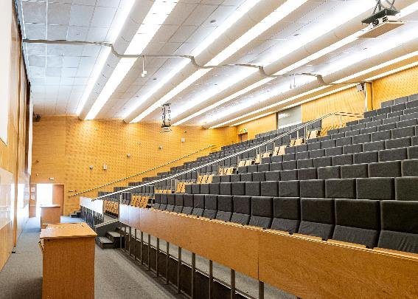
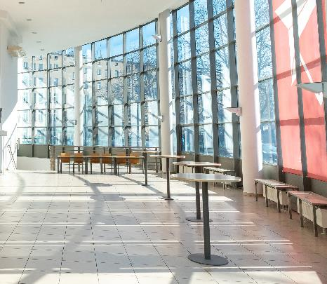
The Wrocław University of Science and Technology Congress Centre
The Congress Centre comprises three conference halls with a total capacity of 620 seats. The centre can be divided into modules in a theatre-style arrangement,
in the following ways: one hall with 620 seats, one hall with 320 seats, one hall with 300 seats, hall with 460 seats, 2 halls with 160 seats each.
3 conference hall+ 3 smaller seminar rooms
Professional equipment, including a system for simultaneous translations
Sound recording of the conference
Wireless internet
Variable lighting system
Exhibition complex
Professional event service
www.konferencje.pwr.edu.pl
Notes:
The Congress Hall can be divided into modules in a theatre-style arrangement, i.e:
one hall with 620 seats (700 m2)
one hall with 460 seats, L-shape arrangement (532,4 m2)
one hall with 320 seats (335 m2)
one hall with 300 seats (365 m2)
two halls with 160 seats each (2 x 167 m2)
three conference rooms with 45 seats (school-style arrangement) or 90 seats (theatre-style arrangement) each (3 x 40 m2)

Slide 39

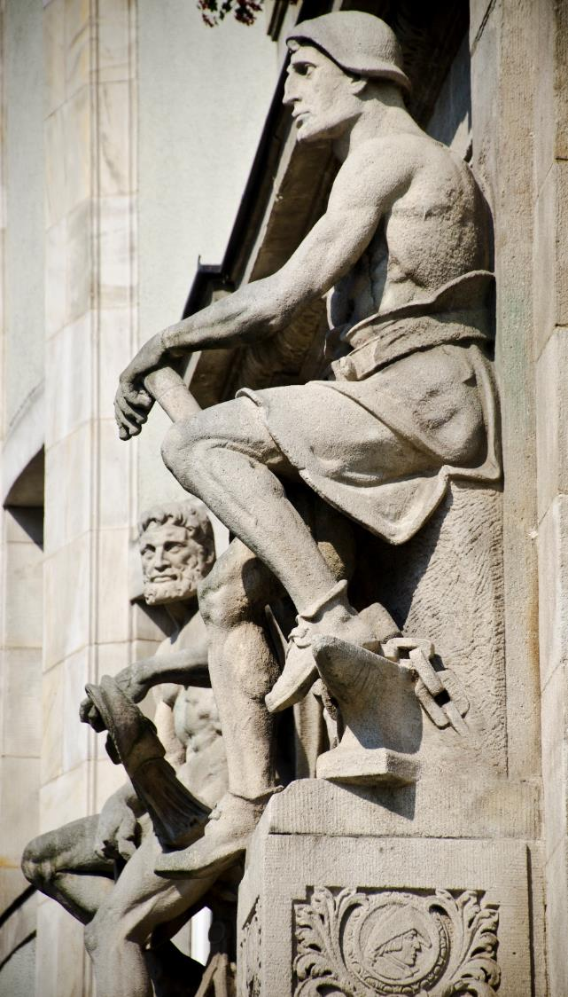
Wrocław Tech Strategy 2023-2030
As a European technical university affirming freedom, truth, curiosity and the joy of learning, we conduct interdisciplinary research and educate to meet the expectations of society and the economy.
The values on which we are founded are:
Excellence – working for progress and sustainability,
we foster personal development based on the highest standards in education, research and innovation.
Interaction – nurturing academic, economic and social partnerships, we combine talents and commitment
to effectively achieve individual and social goals.
Openness – being open to new ideas and challenges, drawing on the diverse experiences and aspirations of members of the academic community, we respond flexibly to changes, treating them as inspiration and motivation to actively participate in the development of science, economy and society.

Slide 40
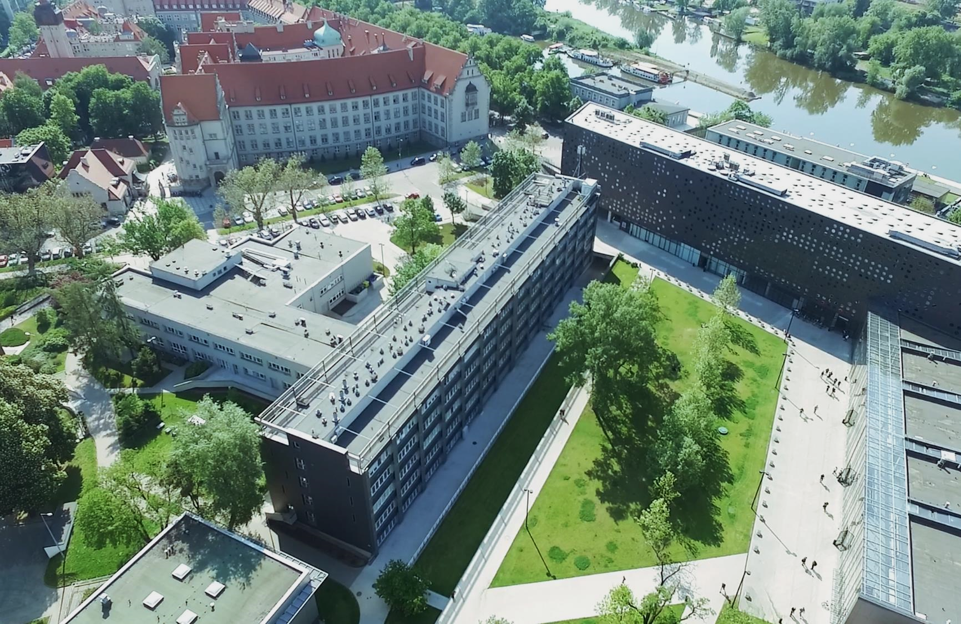



Thank you for your attention
More information:
pwr.edu.pl/en

