Slide 1
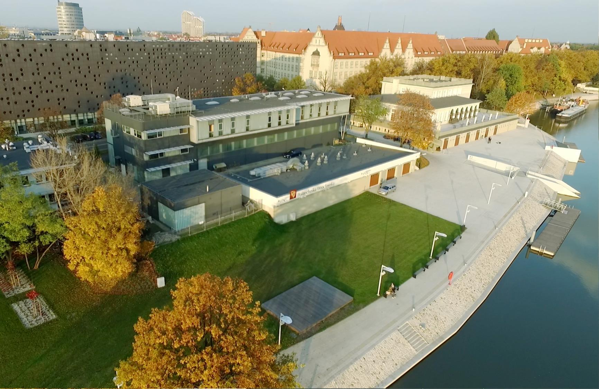
WrocŁaw University
of Science and Technology

Slide 2



Wrocław University
of Science and Technology
  Today’s Wrocław University of Science and Technology
  is the heir to the material legacy of the German Königliche Technische Hochschule Breslau and the intellectual and research traditions of the Lviv University of Technology.
  The university is using its current name since 1945.
  It was established and organised by scientists from Lviv and Warsaw. Since the very beginning of its existence, it has been an important centre of technical education.
  Today it is one the best technical universities in Poland
  – 21 498 students study here under the guidance
  of 2 296 academic teachers, at 14 Faculties in Wrocław
  and 3 branches in Jelenia Gora, Legnica, Walbrzych.
Notes:
20 725 liczba studentów na I i II stopniu kształcenia, stan na 31.12.2023 r.
95 uczestników studiów doktoranckich oraz 678 osób kształcących się w Szkole Doktorskiej (w tym 70 cudzoziemców) stan na 31.12.2023 r.
1 462 studentów obcokrajowców stan na 31.12.2023 r.
2296 nauczycieli akademickich (liczba osób, stan na 30.06.2024 r.) w tym:
liczba osób z tytułem profesora - 205
liczba osób ze stopniem doktora habilitowanego - 419
liczba osób ze stopniem doktora - 1282

Slide 3
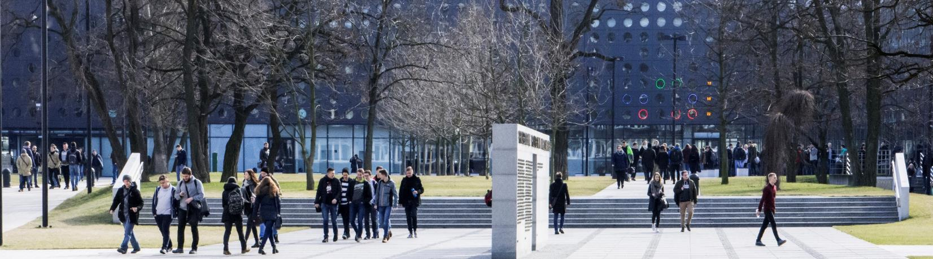
Mission
Wrocław University of Science and Technology (Wrocław Tech) is an autonomous university, a research institution of a university type. Its mission is to shape creative, critical and tolerant personalities of students
and PhD students, also to set directions for the development of science and technology.
The university carries out its public mission through invention and innovation, sharing knowledge, keeping
the highest scientific research standards and quality of education, combine with the freedom of criticism
and respect for the truth.
As an academic community, Wrocław University of Science and Technology, cherishes academic values
and traditions, versatile cooperation with other universities and strives to secure a prominent position among European and world universities.

Slide 4

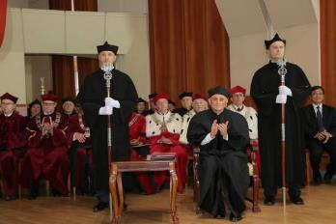
Doctors Honoris Causa
José Manuel Barroso
Daniel Józef Bem
Horst Berthold
Eckhard Beyer
Georgij Konstantynowicz
Boreskow
Andrzej Burghardt
Philippe Busquin
Jerzy Buzek
Gabriel Crean
Eugeniusz Dembicki
Georgij Iwanowicz Denisenko
Karel Duŝek
Rafał Dutkiewicz
Kurt Feser
Alfred Forchel
Elbert Kirtley Fretwell
Kardynał Henryk Gulbinowicz
Henryk Hawrylak
Stanisław Hückel
Giennadij Aleksiejewicz Jagodin
Andrzej Jellonek
Bogusława Jeżowska-
-Trzebiatowska
Moisey I. Kaganov
Alan R. Katritzky
Igor Ignacy Kisiel
Joseph Klafter
Jan Kmita
Stanisław Kulczyński
Krzysztof Kurzydłowski
Philippe Lebrun
Stanisław Lem
Jerzy Leszczyński
Nikołaj Nikołajewicz Malinin
Marja Makarow
Achim Mehlhorn
Jean Meinnel
Angela Merkel
Anatolij Nikołajewicz
Minkiewicz
Kazuo Nakamoto
Reimund Neugebauer
Jean Nougaro
Volodymir V. Panasyuk
Zdzisław J. Pręgowski
Ilya Prigogine
Günter Pritschow
Bengt Ranby
Błażej Roga
Jurij Rudawski
Wacław Franciszek Sierpiński
Jerzy Ignacy Skowroński
Dionizy Smoleński
Joachim Klaus Strzodka
Frans Louis H. M. Stumpers
Karol Széchy
Zygmunt Szparkowski
Władysław Ślebodziński
Ryszard Tadeusiewicz
Hamadoun I. Touré
Jan Trojak
Włodzimierz Trzebiatowski
Kazimierz Urbanik
Zenon Wiłun
Andrzej Wiszniewski
Wojciech Witkiewicz
Władysław Karol Włosiński
Michel Virlogeux
Michel Virlogeux, year of posting: 2022, professor at École Nationale
des Ponts et Chaussées
Wojciech Witkiewicz, year of posting: 2017, professor of medical sciences, director of the Provincial Specialist Hospital - Research and Development Center in Wrocław, president of the Polish Society of Robotic Surgery; specialization: vascular surgery, angiology, transplantation
Notes:
pwr.edu.pl/uczelnia/informacje-ogolne/historia-i-rozwoj/osobistosci/doktorzy-honoris-causa

Slide 5
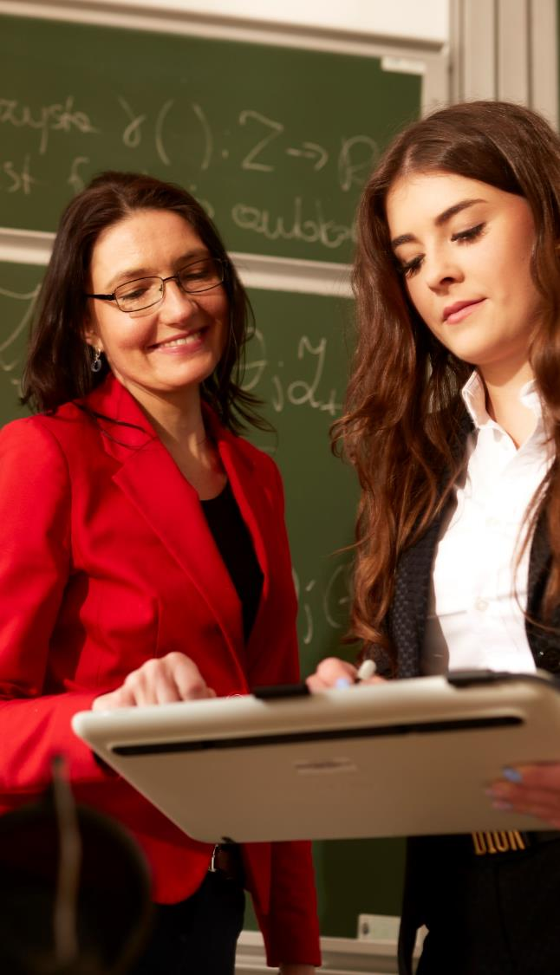
Figures
Fields of study | 70
Students | 20 725
Doctoral students | 773
Academic staff | 2 296
Professors | 205
with the degree of habilitated doctor | 419
PhD holders | 1 282
Notes:
20 725 liczba studentów na I i II stopniu kształcenia, stan na 31.12.2023 r.
95 uczestników studiów doktoranckich oraz 678 osób kształcących się w Szkole Doktorskiej (w tym 70 cudzoziemców) stan na 31.12.2023 r.
1 462 studentów obcokrajowców stan na 31.12.2023 r.
Liczba nauczycieli akademickich ogółem: 2296 osób (stan na dzień 30.06.2024 r.) w tym:
- z tytułem profesora - 205 os.
- ze stopniem doktora habilitowanego - 419 os.
- ze stopniem doktora - 1282 os.
liczba zatrudnionych stan na 30.06.2024 r. w podziale:
1) aktualna liczba pracowników dydaktycznych - 527 os.
2) aktualna liczba pracowników badawczo-dydaktycznych - 1652 os.
3) aktualna liczba pracowników badawczych - 117 os.
4) aktualna liczba pracowników niebędących nauczycielami akademickimi - 2372 os.
liczba uruchomionych kierunków studiów w roku 2023/2024 - 112

Slide 6
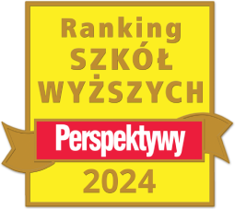



Wrocław University Science and Technology in the rankings
Perspektywy University Ranking 2024
7th place in the general ranking of universities
4th place among Polish technical universities
Center for World University Ranking 2024-2025
13^{h} place among 41 Polish universities and scientific institutions included
in the ranking
.
QS World University Rankings 2025
9th place among Polish universities
28th place in QS Europe University Rankings – Eastern Europe
Notes:
OS 2025
9. miejsce w rankingu polskich uczelni
28. miejsce w rankingu uczelni z krajów Europy Wschodniej
322. miejsce wśród europejskich uczelni
44 naukowców PWr. jest na Liście TOP 2 % - najbardziej wpływowych ludzi nauki na świecie. Ranking opracowują analitycy z Uniwersytet Stanforda, wydawnictwa Elsevier i firmy SciTech Strategies.

Slide 7

EDUCATION

Slide 8
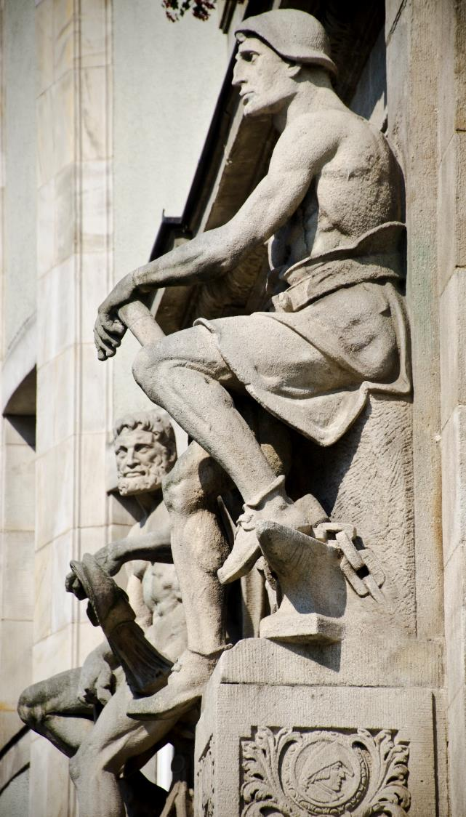
Fields
Wrocław University of Science and Technology conducts research in the following fields of engineering and technical, exact and natural, social sciences and medical and health sciences:
Architecture and Urban Planning
Automation, Electronics, Electrical Engineering and Space Technologies
Information and Communication Technology
Biomedical Engineering
Chemical Engineering
Civil Engineering, Geodesy and Transport
Mechanical Engineering
Materials Engineering
Environmental Engineering, Mining and Energy
Medical Sciences
Mathematics
Chemical Sciences
Physical Sciences
Management and Quality Studies
Notes:
aktualizacja 1.07.2024 r.
nazwy dyscyplin w języku angielskim – załącznik nr 2 do PO 6/2024
Architecture and Urban Planning
Automation, Electronics, Electrical Engineering and Space Technologies
Information and Communication Technology
Biomedical Engineering
Chemical Engineering
Civil Engineering, Geodesy and Transport
Materials Engineering
Mechanical Engineering
Environmental Engineering, Mining and Energy
Mathematics
Chemical Sciences
Physical Sciences
Management and Quality Studies
Medical Sciences

Slide 9
Faculties
Faculty of Architecture
Faculty of Civil Engineering
Faculty of Chemistry
Faculty of Information and Communication Technology
Faculty of Electrical Engineering
Faculty of Geoengineering, Mining and Geology
Faculty of Environmental Engineering
Faculty of Management
Faculty of Mechanical and Power Engineering
Faculty of Mechanical Engineering
Faculty of Fundamental Problems of Technology
Faculty of Electronics, Photonics and Microsystems
Faculty of Pure and Applied Mathematics
Faculty of Medicine
Wrocław Tech Branch in Jelenia Góra
Wrocław Tech Branch in Wałbrzych
Wrocław Tech Branch in Legnica
Since its very beginnings, WUST has aimed to deliver high quality education.
Its multidisciplinary character goes beyond the traditional fields of engineering, interweaving technical, mathematical, natural and economic sciences with humanities.
Notes:
pwr.edu.pl/en/
wykaz nazw wydziałów, kierunków studiów, specjalności – załącznik nr 1 do PO 6/2024

Slide 10

Doctoral school
The Wrocław University of Science and Technology Doctoral School began
its operation on October 1, 2019. Candidates can take up education in one
of thirteen disciplines:
Field of engineering and technical sciences
Architecture and Urban Planning
Automation, Electronics, Electrical Engineering and Space Technologies
Information and Communication Technology
Biomedical Engineering
Chemical Engineering
Civil Engineering, Geodesy and Transport
Mechanical Engineering
Materials Engineering
Environmental Engineering, Mining and Energy
Field of exact and natural sciences
Mathematics
Chemical Sciences
Physical Sciences
Field of social sciences
Management and Quality Studies
Notes:
akt.21.08.2024

Slide 11

Education quality and accreditation
European Chemistry Thematic Network
Chemistry Doctorate Eurolabel Certification for studies in Chemical Engineering
Eurobachelor Certification for studies in Chemistry and Industrial
Analytics, Chemical Technology
Euromaster Certification for studies in Chemistry and Chemical
Technology
Science Evaluation Committee (KEN) discipline assessment 2017-2021:
Category A+:
Physical sciences
Chemical sciences
Mathematics
Chemical engineering
Category A:
Architecture and urban planning
Automation, electronics
and electrical engineering
Technical informatics and telecommunications
Biomedical engineering
Civil engineering and transportation
Mechanical engineering
Material Engineering
Environmental engineering, mining and energy
Management and Quality Sciences
European Consortium for Mathematics in Industry
accreditation for II degree of education studies in Applied Mathematics
Accreditation of Studies with a Future 2021
Management of first-cycle studies
European Accreditation of Engineering Programmes
accreditation for studies in Electotechnics
accreditation for studies in Civil Engineering
accreditation for Biotechnology, Chemical and Process Engineering,
Chemical Technology
European University Association (EUA-IEP)
accreditation for Wrocław University of Science and Technology
Association of Academic Centers for Teaching Foreign Languages (SERMO)
Foreign Language Center of Wrocław University of Science and Technology
- distinctive grade
IES and ICI international certificate for graduates
accreditation for studies in Management
accreditation for studies in Business Engineering
All graduates of the certified educational programs are entitled to receive the IES and ICI international certificates
Notes:
aktualizacja 09.07.2024 r.

Slide 12


HR Excellence in Research
In June 2016 European Commission granted our University the logo "Human Resources Excellence in Research". The logo is given to those institutions that apply the principles of the European Charter for Researchers and
the Code of Conduct for the Recruitment of Researchers.
Logo "HR Excellence in Research" is awarded, among others, in international grant competitions of the European Commission, national grant competitions of the National Center for Science
and the National Centre for Research and Development and competitions and funding programs of the Ministry of Science and Higher Education.
Logo "HR Excellence in Research" emphasises the Wrocław University of Science and Technology importance as an institution which creates the best working conditions for scientists, implementing research and scientific development
in accordance with the European standards.

Slide 13

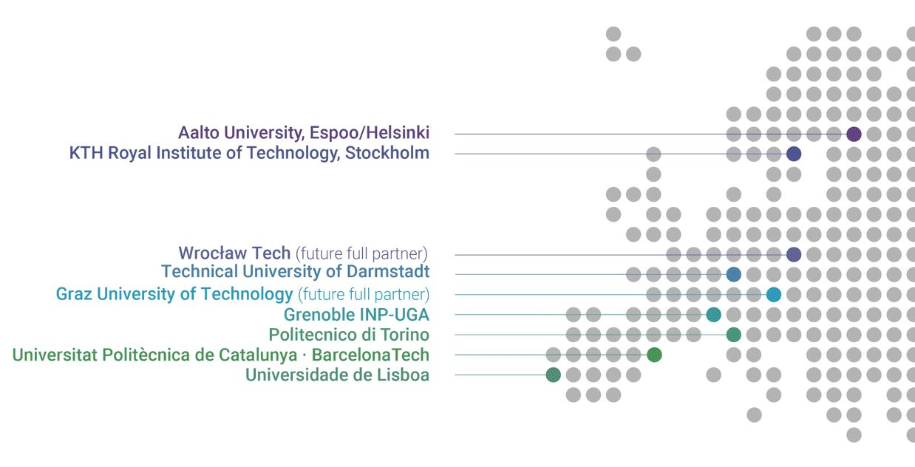
University Network for Innovation,
Technology and Engineering
In September 2022 Wrocław University of Science and Technology joined the prestigious European network
of universities. The aim of this elite organization, uniting universities from nine EU countries, is to create a model
of education that responds to the challenges of the modern world.
Unite! network was established in 2019 thanks to the initiative of the European Commission, assuming the creation
of a European Education Zone by 2025. Currently in part of Unite! nine leading European universities enter. WUST is the first to represent in Unite! eastern part of the Old Continent.
The member universities focus on continuous improvement of the teaching process, development of joint research projects and a flexible study path, and combining science and humanities in the process of educating students.
Notes:
Sieć Unite!
Uniwersytet w Grenoble (Francja),
Uniwersytet w Lizbonie (Portugalia),
Królewski Instytut Technologiczny w Sztokholmie (Szwecja),
Aalto University (Finlandia),
Uniwersytet Techniczny w Darmstadt (Niemcy),
Politechnika w Turynie (Włochy),
Uniwersytet Techniczny Katalonii - Barcelona Tech (Hiszpania),
Politechnika Wrocławska,
Uniwersytet Techniczny w Graz (Austria).

Slide 14

INFRASTRUCTURE

Slide 15

Research and teaching facilities
  116 buildings with modern laboratories, libraries
  and multimedia teaching rooms
  552 didactic laboratories
  501 research laboratories
  454 teaching rooms and lecture halls
  sports centre
  computer laboratories and reading rooms with 24h Internet connection
Notes:
stan na 30.05.2024 r.

Slide 16

International cooperation

Slide 17

Current international agreements
Bilateral cooperation agreements - inter-university and inter-faculty
236 partners from 42 countries
Bilateral student exchange agreements (student exchange)
35 partners from 15 countries
Double diploma agreements
13 partners from 5 countries
Agreements regarding academic mobility in the Erasmus + program
745 active European agreements and 317 with partners from other countries
of the world.
INTERNATIONALISATION | 2023/2024
Foreign students on I and II study degree | 1 376
Foreign students on III study degree and in Doctoral School | 70
Incoming students including ERASMUS+ | 324
Students exchange including ERASMUS+ | 239
Notes:
Aktualne umowy międzynarodowe – wszystkie umowy aktualne na 30.06.2024 r.
Studenci zagraniczni – stan na dzień 31.12.2023 r.

Slide 18


Program ERASMUS+
Participation of the WUST students and doc.
PROGRAM | 2023/2024
Erasmus+ studies | 239
Erasmus+ student internships | 11
Erasmus+ short-term mobility | 59
Erasmus+ graduate internships | 13
Exchange | 9
Double Diploma | 8
TOGETHER | 339
Arrivals of students and doctoral students
Erasmus+ studies | 2023/2024
Erasmus+ KA 131 | 314
Erasmus+ KA 171 | 5
Visiting Student | 0
Exchange | 23
Erasmus Mundus | 49
Double Diploma | 1
TOGETHER | 392
Notes:
39 krótkich mobilności 5-30 dni (BIP, szkoła letnia) stan na dzień 08.07.2024 r. ostateczna liczba zrealizowanych mobilności będzie znana 30 września 2024

Slide 19

Program ERASMUS+
Staff arrivals
PROGRAM | 2023/2024
Erasmus+ KA103 (lectures) | 4
Erasmus+ KA103 (training arrivals) | 10
Erasmus+ KA107 (lectures) | 2
Erasmus+ KA107 (training arrivals) | 11
TOGETHER | 27
Staff travels
PROGRAM | 2023/2024
Erasmus+ KA103 (wykłady) | 72
Erasmus+ KA103 (wyjazdy szkoleniowe) | 178
Erasmus+ KA107 (wykłady) | 0
Erasmus+ KA103 (wyjazdy szkoleniowe) | 0
TOGETHER | 250
Notes:
Dane za rok akademicki 2023/2024 – stan na dzień 08.07.2024 r. ostateczna liczba zrealizowanych mobilności będzie znana 30 września 2024

Slide 20

WROCŁAW UNIVERSITY OF SCIENCE
AND TECHNOLOGY FOR THE YOUTH

Slide 21

Wrocław University of Science
and Technology for the youth
Open days
Team programming contests
Competition in maths and logic games
Chemistry contest
Young Researchers Academy
Courses for candidates
Cooperation with secondary schools
Lower Silesian Festival of Science
Polilab
Studium talent
Notes:
@polilabPWr
roboticarena.pl/pl/
prk.pwr.edu.pl/projekty/wspolpraca-ze-szkolami-srednimi
prk.pwr.edu.pl/projekty/szkoly-partnerskie
amo.pwr.edu.pl/
prk.pwr.edu.pl/projekty/wybitnie-uzdolnieni-na-pwr

Slide 22

Student activities
210 Scientific organizations
Among others: PWR Racing Team, PIRM Mobile Vehicles and Robots Scientific Circle, Students Scientific Society KoNaR, Academic Aviation Club, Bio-Top, ALLIN, Wireless Group, PWR Solar Boat Team, Energy Loop, Audio Engineering Society AES
26 Student associations
Among students’ organizations, the ones with national or international span are the most distingushing and active: BEST Wrocław, AIESEC, NZS, IAESTE, SEP, Erasmus Student Network ESN.
22 Student culture centres
Among others: POLITECHNIKA Film Discussion Club, Wrocław University
of Science and Technology Academic Choir, BIG BAND music group, FOSA Academic Filmmakers Club, SpAF Association of Para-artistic Photography, University’s Orchestra, STYK Students Television.
Notes:
Ostatnia aktualizacja 08.07.2024 r.

Slide 23

Modern University
Prospective students:
on-line registration at: rekrutacja.pwr.edu.pl/en
official website: pwr.edu.pl
Students:
electronic student ID
electronic student record book
cooperation with companies and institutions, opportunities
for internships and trainings
Teaching:
studying in foreign languages

Slide 24

Science and research

Slide 25

Research
Scientific research results
24 053 publications in journals on the ISI Master Journal List
22 212 publications in JCRI indexed journals
  6 215 registered inventions, including utility models
  2 796 patents obtained
Commercialisation of research results:
hundreds of original technical solutions, research
and technology methods used in industry
numerous license agreements to use inventions
Notes:
liczba publikacji – stan na dzień 1.07.2024 r
liczba zgłoszeń wynalazków, wzorów użytkowych i patentów – stan na dzień na dzień 7.07.2024 r.

Slide 26


Cooperation with industry
TRAINING RESEARCH TECHNOLOGY EXPERTISE APPLICATION
Goals
joint research and implementation work
in various industry sectors
development of new technologies
teaching and engineering staff; upgrading
their professional skills
cooperation on using research, teaching
and training facilities
opportunities for internships, student stays and diploma theses
alumni career support
development of academic entrepreneurship
commercialization of research results
preparation and implementation of projects
financed from domestic and foreign funding
promotion of modern technologies
Notes:
biznes.pwr.edu.pl/en/

Slide 27

Certified laboratories
Accredited Laboratory of Standards and Metrology of the Electromagnetic Field (research and calibration laboratory),
Accredited Acoustics Testing Laboratory,
Accredited Belt Transport Laboratory,
Accredited Work Safety Laboratory,
Accredited Testing Laboratory for Transport Infrastructure Facilities,
Accredited Laboratory for Electromagnetic Compatibility,
Accredited Laboratory of the Department of Machine Design
and Testing,
Accredited Chemical Laboratory for Multi-element Analyzes.
Notes:
8 laboratoriów akredytowanych, stan na 30.07.2024 r.

Slide 28



The Wrocław University of Science
and Technology Congress Centre
The Congress Centre comprises three conference halls with a total capacity of 620 seats. The centre can be divided into modules
in a theatre-style arrangement, in the following ways: one hall with 620 seats, one hall with 320 seats, one hall with 300 seats, hall with 460 seats, 2 halls with 160 seats each.
3 conference hall+ 3 smaller seminar rooms
Professional equipment, including a system for simultaneous translations
Sound recording of the conference
Wireless internet
Variable lighting system
Exhibition complex
Professional event service
www.konferencje.pwr.edu.pl
Notes:
The Congress Hall can be divided into modules in a theatre-style arrangement, i.e:
one hall with 620 seats (700 m2)
one hall with 460 seats, L-shape arrangement (532,4 m2)
one hall with 320 seats (335 m2)
one hall with 300 seats (365 m2)
two halls with 160 seats each (2 x 167 m2)
three conference rooms with 45 seats (school-style arrangement) or 90 seats (theatre-style arrangement) each (3 x 40 m2)

Slide 29

Third generation
Third Generation Universities are the idea of a modern university which, in addition to teaching and research, also implements research results into the economy. These types
of universities have developed technology transfer centers, business incubators and are conducive to the creation of specialized research groups, where English is the basic language of work.
Main goals of Wrocław University of Science and Technology as the Third Generation University:
education
research
commercialization of knowledge
cooperation with the region and the city.
Notes:
Strategy of Wrocław University of Science and Technology 2023-2030
pwr.edu.pl/en/university/about-us/strategy

Slide 30

Strategy of Wrocław University
of Science and Technology 2023-2030
Mission
Through research, teaching, and collaboration we inspire and support the development of individuals who, based on knowledge, ethical standards and displaying sensitivity to the needs of society and global challenges, shape the future with courage and responsibility.
Vision
Vision As a European comprehensive technical university affirming freedom, truth, curiosity, and joy of science, we conduct interdisciplinary education and research in response to the aspirations and challenges of the society and economy.
Values
Excellence – in education, research and knowledge transfer, and in personal development of our community members.
Collaboration – understood as combining individual talents to achieve common goals, mutual support in achieving individual goals, and the University’s cooperation with its environment.
Openness – to new ideas and challenges and in relation to University community members.
Notes:
Full text of the Strategy of Wrocław University of Science and Technology: pwr.edu.pl/en/university/about-us/strategy

Slide 31




Thank you for your attention
More information:
pwr.edu.pl/en

